Slide 1
Parking Sensors: Analyzing and Detecting Parked Domains
NDSS 2015
Thomas Vissers, Wouter Joosen , Nick Nikiforakis
Presented by Yi Yuan
Notes:
Networking and Distributed System Security

Slide 2
Motivation
Domain names
- First-come first-serve → one for each person/company → paying model
Domainers
- selling domain names : wine.com casino.com
- Pay-Per-Click
Domain parking services
- incorporate ads on their domains
- no worrying about finding advertisers and setting up contracts.

Slide 3
Outline
Background
-Motivation, related works, contributions.
Domain Parking Ecosystem
Analysis of Parked Domains
Detecting Parked Domains
- classifier with evaluation
Discussion and Conclusion

Slide 4
Related Works
Alrwais et al. studied domain parking form the point of view of advertiser and domain owner: hiding clicks, click fraud[1]
- only focus on the abuse against advertiser.
Almishar et al. developed a classifier for “ads-portal” domains in 2008: tyopsquatting abuse [2]
- did not incorporate HAR features
- did not take into account redirection, no in-depth frame analysis
Typosquatting research
-51% of all the possible tyopsquatting domains of websites in the Alexa top 10,000
were registered and active in 2006. [3]
- 63% of tyopsquatting domains were using Google PPC ads. [4]

Slide 5
Contributions:
Study of domain parking services, mapping out the entire ecosystem:
focus on everyday web users
Parked pages expose the user to a series of dangers:
malware, scams and inappropriate content
Present of an large number of tyopsquatting domains and demonstrate the lack of control
Propose a classifier for detecting parked pages

Slide 6
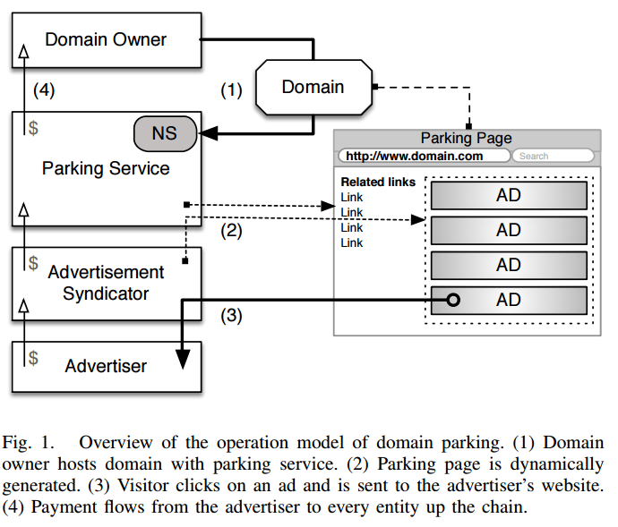
Domain Parking Ecosystem

Slide 7
Domain Parking Ecosystem
How do users end up on parked domains?
Typosquatting: wikipdeia.org → wikipedia.org
“guess” domain name
Gather Parked Domains
a survey amongst Domainers, the top results of Alexa.com and Google.com when querying for domain parking, and a thread from a popular domaining forum → collection of 15 services
Search the record of DNS Census dataset (2.5 billion DNS records)
Match the configurations of 15 services
Total 8,064,914 actively parked domains from the 15 services

Slide 8
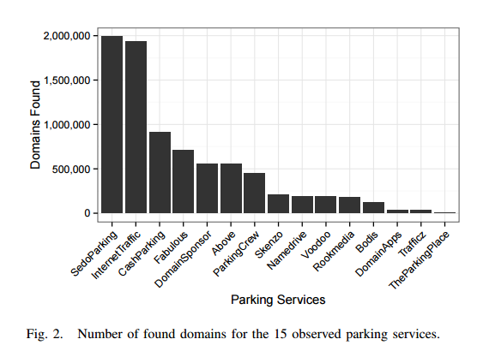
Domain Parking Ecosystem

Slide 9
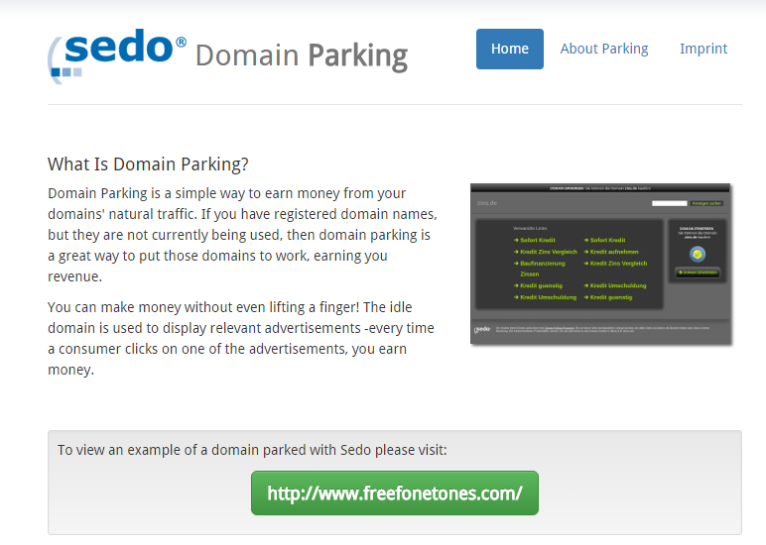
Domain Parking Ecosystem

Slide 10
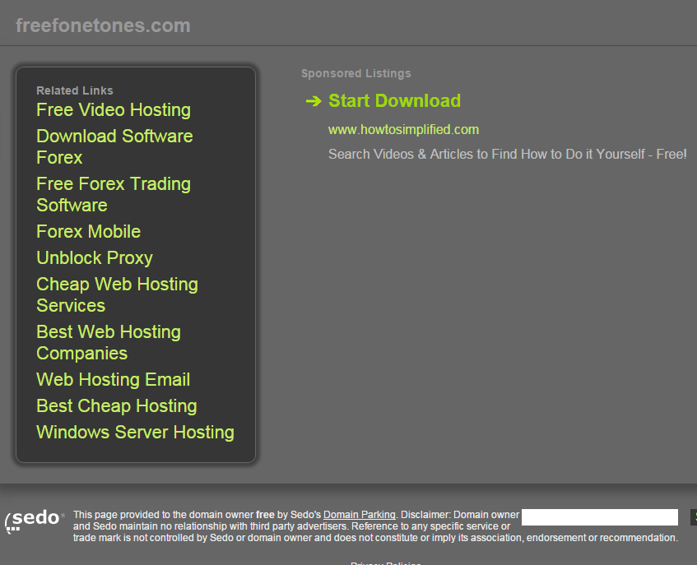
Domain Parking Ecosystem

Slide 11
Analysis of Parked Domains
Parked Domain Owners
Request WHOIS data from 3k randomly-selected parked domains
Filter out the records: anonymized or unpassable
Extract information & group together: same name, email address…
Merge clusters of domains: same individual or organization
Results: 910 distance domain owners with 1,582 parked domains

Slide 12
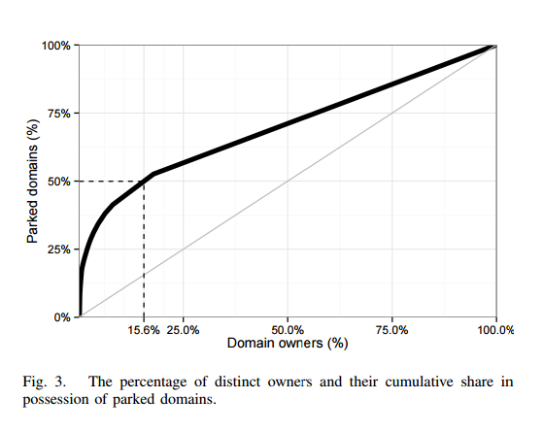
Analysis of Parked Domains

Slide 13
Analysis of Parked Domains
Advertisement Syndicators
Advertising: pay-per-click (PPC)
- user → domain owner, domain parking service
Third-party ad syndicators
- easier, more scalable
Sampled 3k parked domains
- Crawl those domains, and inspected their source code
- AdSense, DoubleClick, Media.net and Chango

Slide 14
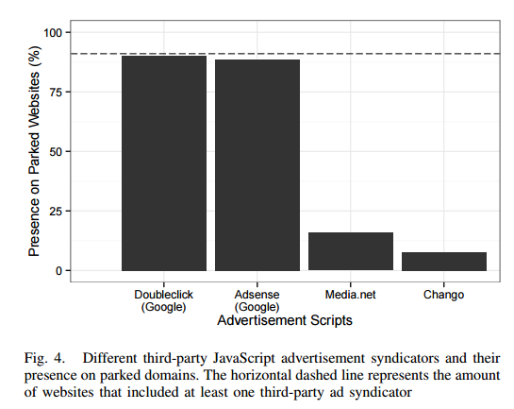
Analysis of Parked Domains
Doubleclick(90%+1.1%) Adsense (88%+1.2%), both google products
Google stopped their own hosted parking service due to lawsuits.
At same time, google start to keep parked pages away from its search results.
.

Slide 15
Analysis of Parked Domains
Typosquatting abuse
Typosquatting sites are illegal under the AntiCybersquatting Consumer Protection Act (ACPA)
eg: vacebook.com → facebook.com
Reverse-typo transformation
Two example:
missing-dot: wwwfacebook.com → www.facebook.com
Character-insertion: www.faceebook.com → www.facebook.com
Apply reverse-typo transformation to the 8 million parked domains
Total 131,673 tyopsquatting domains (1.63%).

Slide 16
Analysis of Parked Domains
Parking a tyopsquatting Domain
experiment
Register a tyopsquatting domain: stcakoverflow.com →stackoverflow.com
Domain name was owned by a typo-squatter but expired
Both four services need verification
But not a single service denied the submission of this abusive domain
According to the services’ statistics, parking page was receiving victors daily
Result
Taking advantage of squatting domains appears to be part of domain parking services everyday operations.

Slide 17
Analysis of Parked Domains
Trademark abuse
Typosquatting domains belong to the trademark abuse category
Eg: facebookonline.com → facebook.com
Randomly selected 500 parked domains
79 (16%+/-3.2%) of 500 were abusing trademarking
29 (6%+/-2%) of domains abusing existing trademark, displayed advertisements of competitor.

Slide 18
Analysis of Parked Domains
Malicious redirections
Domain parking companies help visitor by showing tem relevant advertising links: true for domains without trademark or tyopsquatting issue
Three types of malicious redirection
Malware
- host may download executable that are flagged as malware
- convince visitor to download a malicious update their Flash player or browser.
Scams
- Persuade users to hand over sensitive info such as SSN
- Claims that the visitor’s computer is infected with malware
Adult websites

Slide 19
Analysis of Parked Domains
Detecting and Bypassing Ad-Blockers
Ad-blocking extension
Domain parking services attempt to detect and bypass advertising blockers:
NameDriver:
Additional detection mechanism for ad blockers
Fabulous.com:
Contain JavaScript code that verifies whether the JavaScript object named google exists.

Slide 20
Detecting Parked Domains
Gathering data
3k random sample from parked page, 3k pages from the Alexa top 1 million
Crawl 6k pages and collect data from serval different sources.
Gather the HTML source code
Record a trace of all HTTP requests initiated by the web page (HAR),chains of main page and every frame
Inspect properties of all domain itself such as tyopsquatting occurrence and WHOIS records.
Extract feature that can serve as input for classifier

Slide 21
Detecting Parked Domains
Feature set
HTML features:
Average and maximum link length
Average source length
External link and external source ratio
Website directory presence.
Link-to-global text ratio
Amount of non-link characters
Text-to-HTML ratio
Redirection mechanisms

Slide 22
Detecting Parked Domains
Feature set
HAR features
Third-party requests ratio
Third-party data ratio
Third-party HTML content ratio
Initial response size and ratio

Slide 23
Detecting Parked Domains
Feature set
Frame features
Amount of frames
Main frame and iframe redirections
Different final domain
Domain name feature
Typosquatting domain

Slide 24
Detecting Parked Domains
Classification
Learning method:
Use Random Forest algorithm
Decision trees
Quick in the detection phase

Slide 25
Detecting Parked Domains
Classification
Dataset handling:
Train and test dataset: 2/3 train data, ½ test data
Data transformation: remove outlier and extreme values from training set
Omitted features: remove two feature which are less discriminative and reduce performance.

Slide 26
Detecting Parked Domains
Classification
Evaluation:
Using Random Forest with 10-fold cross validation
1000 unseen parked and 1000 unseen benign instances.
Two threshold points: 0.5 and 0.7

Slide 27
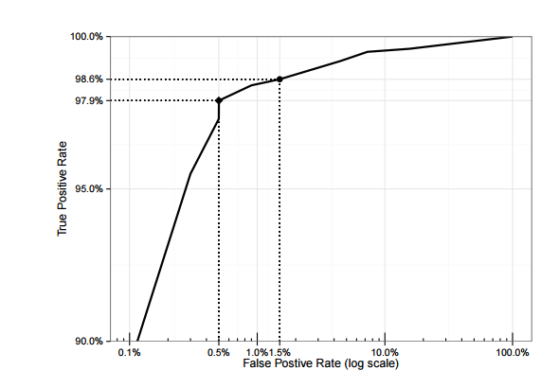
Detecting Parked Domains

Slide 28
Detecting Parked Domains
Classification
Detection Evasion:
Decrease the relative presence of third-party advertising by either providing a large portion of first0party content for each domain
Redirection chains and mechanism are tracked in every frame, so the PPR would need to be abandoned.
Typosquatting domains could be excluded from parked domain to reduce detection
Domain parking industry would either be forced to a more legal business model or lose its remaining exposure to users.

Slide 29
Discussion
Limited added value to the web
Business climate for Domainers has changed
Advances in browser technologies: reduced type-in traffic for parking pages
Adoption of ad-blocking tools
Google decided to exclude parked domains from Google’s search results.
Typosquatting domains are still a regular part of business model
Redirected to malware, scams and adult material: pay more than legal redirections.
Domain parking has become a threat for all users on web as well as for the legal advertising industry

Slide 30
Conclusion
Ecosystem of domain parking
identify popular parking services, types of parked domains, advertising content
Multiple types of abuse: malware, scams, adult pages
Discover tyopsquatting domains can be monetized through domain parking
Design and built a classifier
Opinion

Slide 31
Quiz
Name four different parties in ecosystem of domain parking.
What is the role of threshold in the classifier?
Authors pointed that domain parking had become a threat for all users on the web as well as for the legal advertising industry, what do you think?(open)

Slide 32
References List
[1] S. Alrwais, K. Yuan, E. Alowaisheq, Z. Li, and X. Wang, “Understanding the Dark Side of Domain Parking,” in Proceedings of the 23rd USENIX Security Symposium, 2014
[2] M. Almishari and X. Yang, “Ads-portal domains: Identification and measurements,” ACM Transactions on the Web (TWEB), vol. 4, no. 2, p. 4, 2010.
[3] Y.-M. Wang, D. Beck, J. Wang, C. Verbowski, and B. Daniels, “Strider typo-patrol: discovery and analysis of systematic typo-squatting,” in Proceedings of the 2nd conference on Steps to Reducing Unwanted Traffic on the Internet - Volume 2, ser. SRUTI’06. Berkeley, CA, USA: USENIX Association, 2006.
[4] ] T. Moore and B. Edelman, “Measuring the perpetrators and funders of typosquatting,” in Financial Cryptography and Data Security, vol. 6052, 2010, pp. 175–191.

Slide 33
Question?

